Slide 1
Agile & Waterfall Methodology
Brno, Thursday 8th March, 2017)

Slide 2
Waterfall method.
The first formal description was in 1970 by Winston W. Royce.
The earliest use of the term "waterfall" may have been in a 1976 paper by Bell and Thayer.
Iterative method.
Incremental and iterative development are almost always part of an agile development strategy.
Unified Process and Dynamic Systems Development Method (DSDM) - 1994
Scrum – 1995
extreme programming (XP) – 1996
The term agile was first coined for this in 2001, in the Manifesto for Agile Software Development (Agile Manifesto)
created by the Agile Alliance.
The Agile Manifesto lists 12 principles.
Agile refers to any process that aligns with the concepts of the Agile Manifesto.

Slide 3
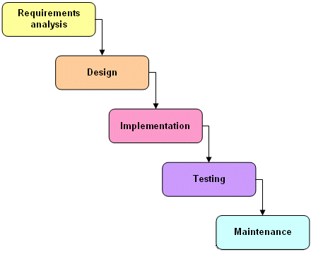
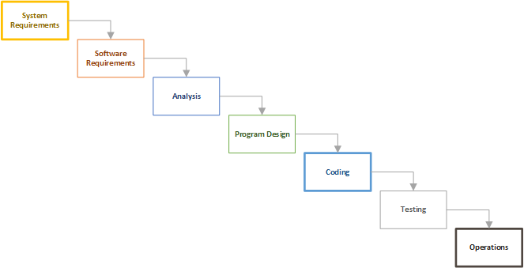
What Is Waterfall?
Sequential and linear process.
Predictive.
Series of discrete phases, each occurring only once the previous phase has completed.

Slide 4
Requirement gathering and analysis
The project team look for functional and non-functional requirements:
The business need.
The user requirements.
The constraints.
The expectations and goals.
The risks.
Software requirements specification (SRS) document.
Establishes the basis for an agreement between customers and contractors or suppliers.
Functional requirements.
Non-functional requirements.
May include a set of use cases.

Slide 5
Design
How the software will be built.
How the system will operate: hardware, software, network infrastructure and user interface.
There are two types of design:
The logical design.
Forms and reports.
The interface.
The database.
The physical design.
Physical database.
The programs and processes.
The distributed systems.
System design specification document (SDS):
Satisfy all documented requirements.
identify all inputs, processes and outputs.

Slide 6
Implementation
Physical construction of the software.
Programmers, interface designers and other specialists.
Reliable software, documentation and tests.

Slide 7
(Integration) Testing
Scope:
individual components
the integrated whole
Approach
Resources
Schedule
Objectives:
Code is error-free.
Fully meet the requirements outlined

Slide 8
Advantages of Waterfall
Easy to understand, easy to use.
Provides structure to inexperienced development team..
Milestones are well understood.
Sets requirements stability.
Ideal for management control (planning, monitoring, reporting).
Works well when quality is more important than cost or schedule.

Slide 9
Disadvantages of Waterfall
Developers can’t go back to a previous stage and make changes.
Waterfall methodology relies heavily on initial requirements.
Errors, new requirements or changes requires to start the project from the beginning with all new code.
The whole product is only tested at the end.
The plan doesn’t take into account a client’s evolving needs.

Slide 10
When to Use Waterfall Model?
Requirements are very well known.
When there is a clear picture of what the final product should be.
When clients won’t have the ability to change the scope of the project once it has begun.
Product definition is stable.
Technology is well understood.
New version of an existing product.
Porting an existing product to a new platform.
Large organization with structured cross-functional teams.
Communication channels are well established within the organization and with the customer as well.

Slide 11
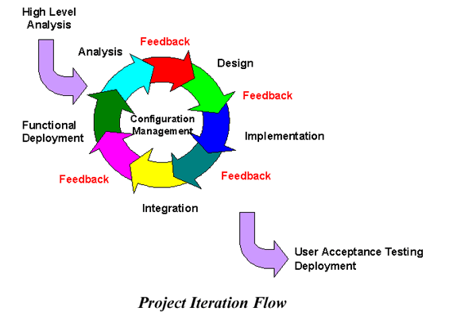
The iterative method
Overcomes many disadvantages of the waterfall model.
It is adaptive.
Occurs over several iterations.
New functional capabilities are added each iteration.
Is incremental.
Each release builds on the previous one.
Each iteration incorporates four processes:
Planning/Analysis.
Design.
Development/Implementation.
Testing.

Slide 12
Planning/Analysis
A team decides what functionality to include in a small release, based on a subset of requirements for a system.
Through analysis, the development team determinates:
Requirements.
The improvements on the existing releases.
Design
A software solution to meet the requirements is designed.
This may be a new design, or an extension of an earlier design with new functional capabilities.

Slide 13
Development/Implementation
Coding involves creating the required software code, as well as unit and system-level tests.
As unit code is completed and tested, it is integrated with other working code at the system level.
Testing
Testing occurs at both the unit and over-all system levels, to ensure that developed software meets requirements.

Slide 14
What Is Agile?
Agile software development is based on an incremental, iterative approach.
The Agile manifesto highlights the value of:
Individuals and interactions over processes and tools.
Working software over comprehensive documentation.
Customer collaboration over contract negotiation.
Responding to change over following a plan.
Business stakeholders and developers must work together to align the product with customer needs and company goals.
Encourages constant feedback from the end users.

Slide 15
What Is Agile?
Agile development is adaptive.
Agile methodologies do not need in-depth planning at the beginning of the project.
Agile methodologies are open to changing requirements over time.
Agile projects are also people-oriented.
Agile programming aims to minimize risk and improve efficiency by focusing on the frequent delivery of smaller,
incremental releases of working software.
The goal of each iteration is to produce a working product.
At the end of each increment in development, agile teams re-evaluate project priorities.

Slide 16
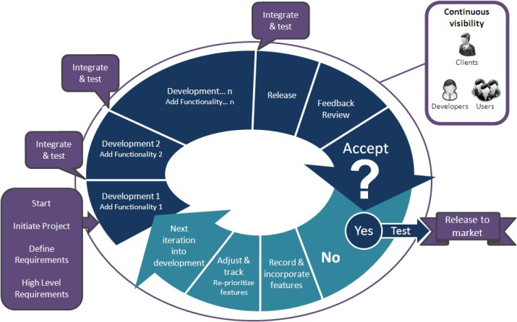
Agile development cycle

Slide 17
Agile key values I
Communication.
Agile development depends on regular, face-to-face communication among all team members.
Teams can make decisions and mitigate problems quickly.
Smaller development teams (2 to about 30 people).
Larger teams make effective communication more difficult and cycles longer.
Feedback.
Feedback from customers is obtained frequently, throughout the development process.
This ensures work can be adapted early rather than late to meet requirements.

Slide 18
Agile key values II
Courage.
Agile development depends on open, honest communication, as well as ongoing acceptance of and adaptation to
change.
Simplicity.
Teams only work on existing customer requirements.
Teams will not work on future needs or new features not required.
Built and tested code is reduced.
Less complex processes and documentation.

Slide 19
Methodologies that are used to implement Agile I
Feature-driven development (FDD).
Adaptive system development (ASD).
Kanban.
Crystal Clear.
Dynamic Systems Development Method (DSDM).
Is probably the original agile development method.

Slide 20
Methodologies that are used to implement Agile II
Extreme Programming (XP).
Software development based on improve quality and responsiveness to evolving customer requirements.
Feedback.
Simplicity.
Adapted to change.
Pair programming (“pairing”) is part of the Extreme Programming (XP) practices.
Scrum.
Scrum is a subset of Agile and one of the most popular process frameworks for implementing Agile.
It is an iterative software development model with fixed-length iterations (sprints) lasting one to two weeks long.
Scrum follows a set of roles and uses visual artifacts to show progress and receive incremental feedback.

Slide 21
Other Practices in Agile
Agile Modeling (AM).
Is not a complete software process.
It is a supplement to other Agile methodologies like Scrum or Extreme Programming (XP).
It can help improve models with code, but it doesn’t include programming activities.
It Is used to model and document software systems.
Rational Unified Process (RUP).
Is like an online mentor that provides guidelines, templates, and examples for program development.
The key aspects include:
risk-driven process.
use case focused development.
architecture-centric design.
Test-Driven Development (TDD).
Based on repetitive, short development cycles.
The developer writes an automated test case (which initially fails) to a new feature.
Quickly adds a test with the minimum amount of code to pass that test.
Then refactor the new code according to acceptable standards.

Slide 22
Advantages of Agile
Early and frequent releases.
Accommodation of changing requirements.
Daily communication among the customer and developers.
Projects built around motivated individuals.
Self-organizing teams.
Simplicity, focusing on what is immediately required.
No building for future or overburdening the code.
Regular reflection to adjust behavior to improve effectiveness.

Slide 23
Disadvantages of Agile
Customer availability may not be possible.
Teams should be experienced to follow the rules of the method.
Appropriate planning is required to quickly decide on the functionality that needs to be delivered in an iteration.
Team is expected to have estimation skills and negotiation skills.
Team should have effective communication skills.
New teams may not be able to organize themselves.
Requires discipline to develop and deliver in time-boxed iterations.
Design needs to be kept simple and maintainable, thus requiring effective design skills.

Slide 24
When to Use Agile methods?
When application is time-critical.
When the scope is limited and less formal.
When there isn’t a clear picture of what the final product should look like.
When clients will be able to change the scope of the project.
When you have skilled developers who are adaptable and able to think independently.
When the product is intended for an industry with rapidly changing standards.

Slide 25
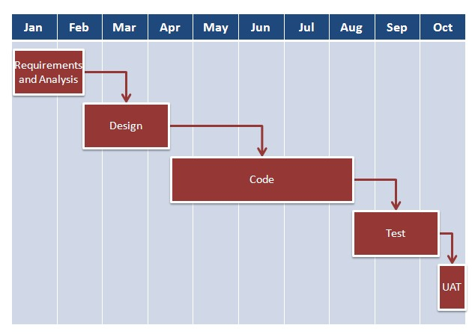
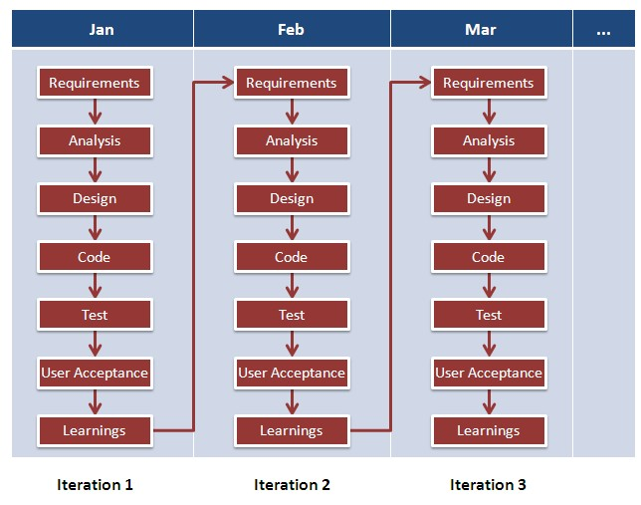
Waterfall vs Agile

Slide 26
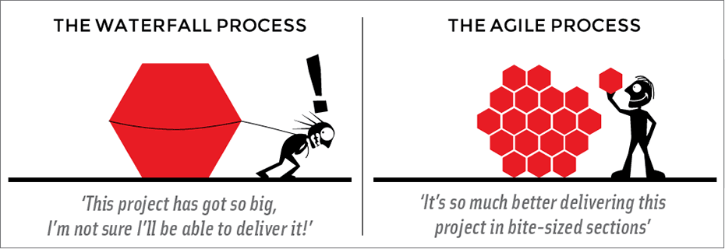
Waterfall vs Agile

Slide 27
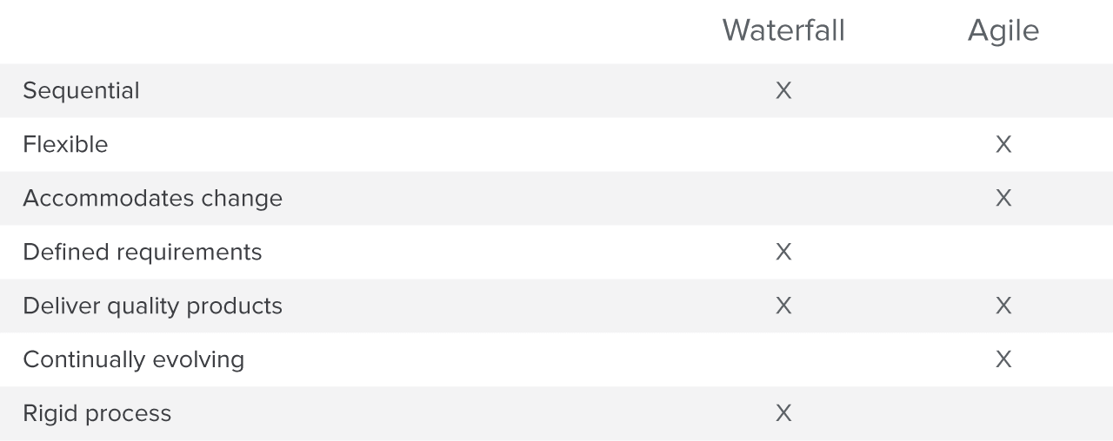
Waterfall vs Agile

Slide 28


Slide 29


